Slide 1
Communication Devices

Slide 2
Modem
Short for modulator/demodulator, a modem is a hardware device that allows a computer to send and receive information over telephone lines. When sending a signal, the device converts ("modulates") digital data to an analog audio signal, and transmits it over a telephone line. Similarly, when an analog signal is received, the modem converts it back ("demodulates" it) to a digital signal.

Slide 3
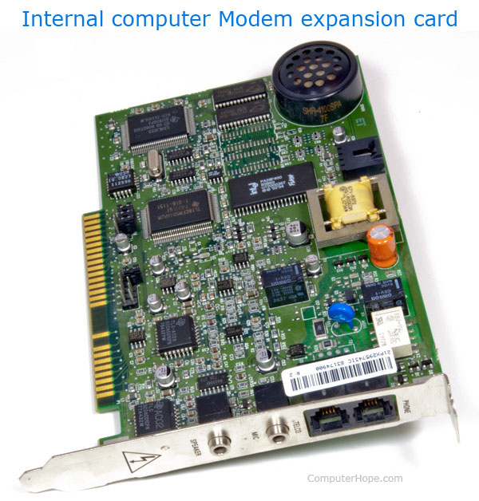
Internal modem
Modem that connects to a PCI slot inside a newer desktop computer or ISA slot on an older computer. The internal modem shown at the beginning of this document is an example of a PCI modem.

Slide 4
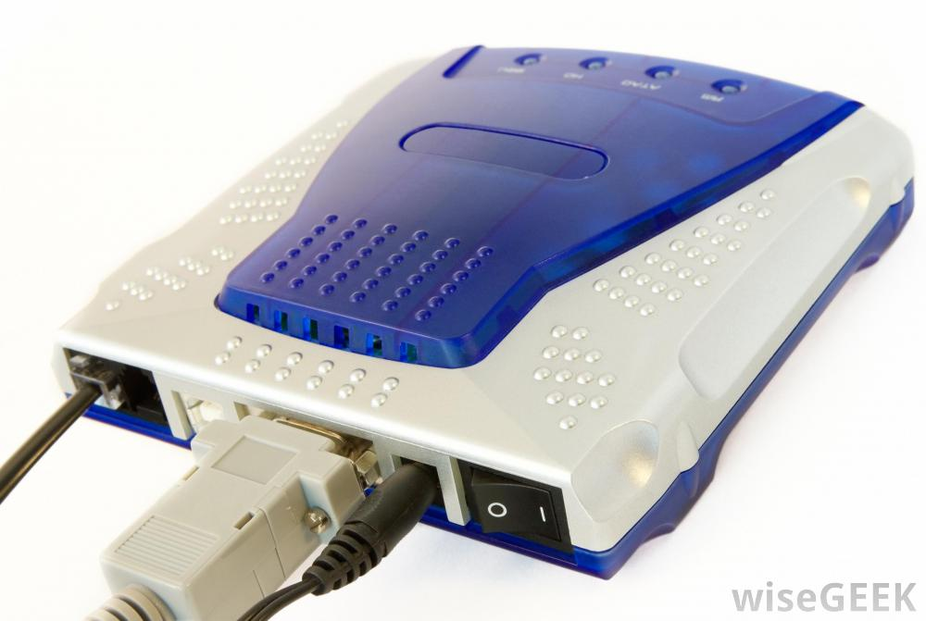
External modem
Modem within a box that connects to the computer externally, usually the serial ports or USB port.

Slide 5
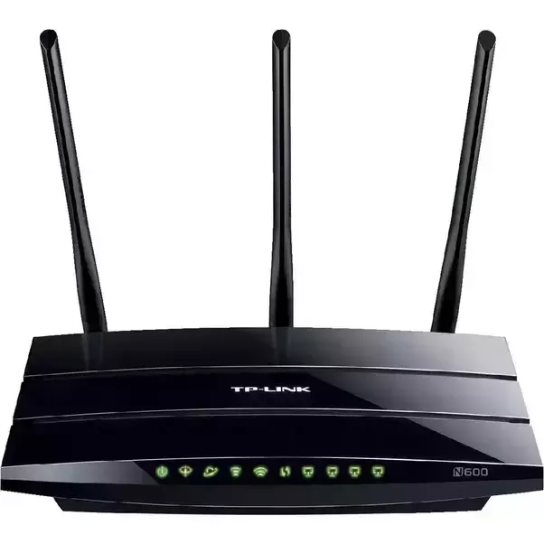
Wireless modem
A wireless modem is a modem that bypasses the telephone system and connects directly to a wireless network, through which it can directly access the Internet connectivity provided by an Internet service provider (ISP).

Slide 6
Network interface card (NIC)
A network interface card (NIC) is a hardware component without which a computer cannot be connected over a network. It is a circuit board installed in a computer that provides a dedicated network connection to the computer. It is also called network interface controller, network adapter or LAN adapter.

Slide 7
Purpose
NIC allows both wired and wireless communications.
NIC allows communications between computers connected via local area network (LAN) as well as communications over large-scale network through Internet Protocol (IP).
NIC is both a physical layer and a data link layer device, i.e. it provides the necessary hardware circuitry so that the physical layer processes and some data link layer processes can run on it.

